Slide 1
LSO322 YA The Five Greatest Ideas in Science
Week 1: Introduction and The Scientific Method

Slide 2
Welcome to LSO322! A Little about Me…
Dr. Jenny Griffin
jennifer.griffin@senecacollege.ca
Department mailbox within main office of School of English and Liberal Studies (ELS)
Office hours: before and after class. Feel free to contact me by email at any time.

Slide 3
Why Study Science…?
What is science?
As defined by the Oxford English Dictionary (OED):
“A branch of study that deals with a connected body of demonstrated truths or with observed facts systematically classified and more or less comprehended by general laws, and incorporating trustworthy methods (now esp. those involving the scientific method and which incorporate falsifiable hypotheses) for the discovery of new truth in its own domain.”
http://www.oed.com.myaccess.library.utoronto.ca/view/Entry/172672?redirectedFrom=science#eid

Slide 4
Why Study Science…(2)
“Science is a way of learning about our physical universe”
Trefil and Hazen “The Sciences an Integrated Approach” 7th Edition Chapter 1
How does learning about our physical universe impact our daily lives?
What is the place of Science in our world?

Slide 5
Why Study Science? (3)
Science
Is
Everywhere!!!

Slide 6
What we’ll do this term…
Introduction to the natural sciences
The Scientific Method
Major developments in:
Physics, Chemistry, Astronomy, Geology and Biology
How were the “great ideas” developed and what was the role of the scientific method?
What was the impact of these great ideas on society?

Slide 7
Evaluation
GRADING / ASSIGNMENTS
Tests 50% (5 Unit tests each worth 10%)
Term Paper 15% (Outline and paper)
Take-Home Assignments 10%
Final Exam 25%

Slide 8
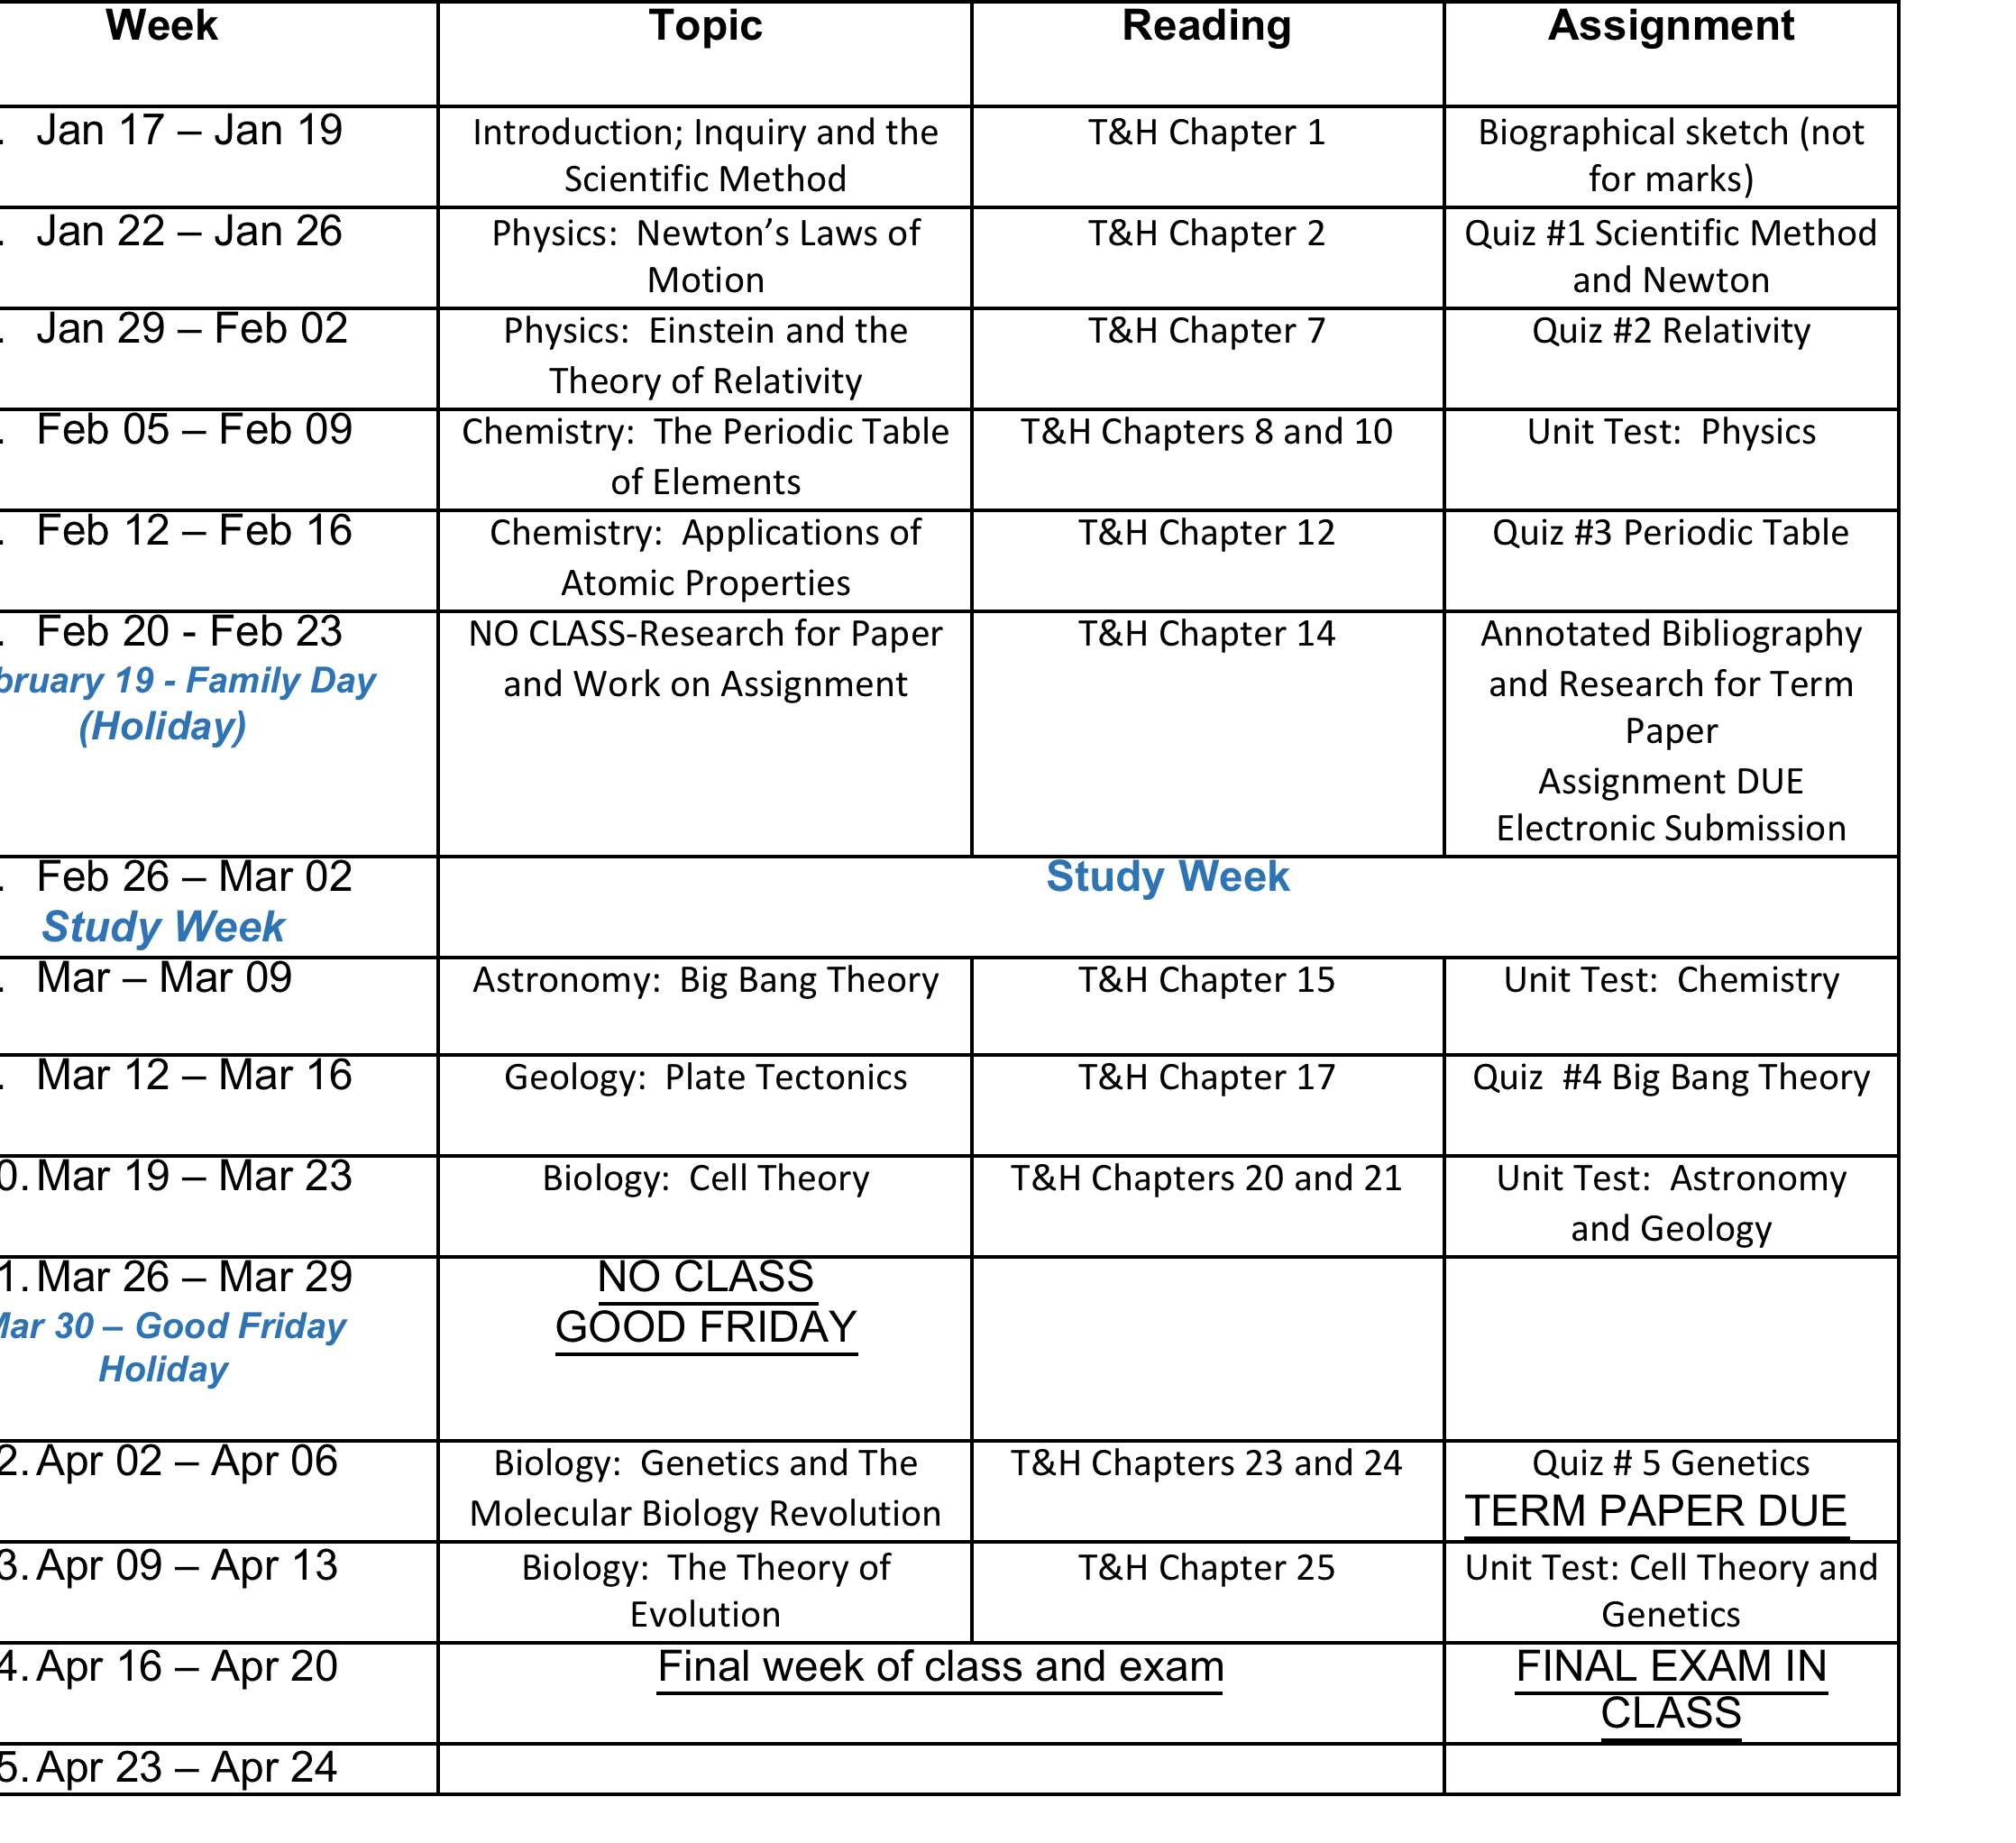

Slide 9
Evaluation
GRADING / ASSIGNMENTS
Tests 50%
(5 Unit tests each worth 10%)
Term Paper 15% (Outline and paper)
Oral Presentation 10%
Final Exam 25%

Slide 10
What you will need this term
"The Sciences An Integrated Approach 7th Edition"
Authors: James Trefil and Robert Hazen (T&H)
Published 2013 by Wiley (Available at Seneca Bookstore)
A good print dictionary and thesaurus
Folder or binder to keep assignments and handouts
Pens and paper
Calculator
Course information will be posted on Blackboard

Slide 11
Observation, Science and the World Around You…
Science is a means to ask and answer questions to understand the physical universe.
How is this done?
Observation (“noticing”)
Asking question(s)
Observation
Description/Testing ideas/Comparison
Form Conclusions

Slide 12
Chapter Outline
The Role of Science
The Scientific Method
Other Ways of Knowing
The Organization of Science

Slide 13
The Role of Science

Slide 14
The Role of Science
Making Choices
Ask questions, make observations, form conclusions
Applied in a more formal, quantitative way equals science

Slide 15
Why Study Science?
Most powerful tool for understanding
Incorporates basic ideas and theories
Provides framework for new questions
Provides unparalleled view of order and symmetry of the universe and its workings

Slide 16
The Scientific Method

Slide 17
Elements
History
Greek Philosophers
Middle Ages
Observation – no manipulation
Experiment – manipulation

Slide 18
Identifying Patterns and Regularities
Measurement-better description
Data-table or graph
Patterns emerge
Describe:
In words
In equation form
In symbols

Slide 19
Mathematics: The Language of Science
Description
General
Mathematical
Mathematics
Equation
Description

Slide 20
Facts, Hypotheses, Laws, and Theories
Fact
Confirmed observation
Hypothesis
Educated guess
Law
Description of nature
Theory
Well-substantiated description

Slide 21
Prediction and Testing
Predictions
Hypothesis, Theory, Law
Must be quantitatively testable
Testing
Do not prove or disprove
Define range of validity
Every law and theory of nature is subject to change, based on new observations

Slide 22
The Scientific Method in Operation
Cycle
Not rigid
Believe results
No preconceptions
No true starting place
Results must be reproducible
Cycle is continuous

Slide 23
The Scientific Method
See Figure 1-7 in Trefil and Hazen

Slide 24
The Ongoing Process of Science
Dynamic process of scientific research
See figure 1-8 in Trefil and Hazen

Slide 25
Science in the Making
Dimitri Mendeleev and the Periodic Table
See Figure 1-9 in Trefil and Hazen

Slide 26
Periodic Table
See figure 1-10 in Trefil and Hazen

Slide 27
The Science of Life
William Harvey and the Blood’s Circulation
See Figure 1-11 in Trefil and Hazen

Slide 28
Other Ways of Knowing

Slide 29
Different Kinds of Questions
Cannot always use scientific method
Art
Use to address age of painting
Not for beauty, etc.
Religion
No conflict between science and religion
Faith vs. experiment

Slide 30
Pseudoscience
Pseudoscience
Belief, dogma
Ideas not testable
Evaluation of a claim
Are the ‘facts’ true as stated?
Is there an alternative explanation?
Is the claim falsifiable?
Have claims been tested?
Do claims require unreasonable changes in accepted ideas?

Slide 31
Fortune Telling
See Figure 1-12 in Trefil and Hazen

Slide 32
Astrology
See Figure 1-13 in Trefil and Hazen

Slide 33
The Organization of Science

Slide 34
Divisions of Science
Disciplines
Historical
Modern
Approach
Field researcher
Experimentalists
Theorists

Slide 35
Scientists Work at Many Different Tasks
See Figure 1-14 in Trefil and Hazen

Slide 36
The Branches of Science
Physics
Fundamental aspects of nature
Chemistry
Atoms in combination
Biology
Living systems
Astronomy
Objects in space
Geology
Earth

Slide 37
The Web of Knowledge
Centre
Laws of nature
Apply to all areas
Areas Interconnected
All branches integrated

Slide 38
The Interconnected Web of Scientific Knowledge
See Figure 1-15 in Trefil and Hazen

Slide 39
Basic and Applied Research and Technology
Basic Research
Expand knowledge
Applied Research
Direct application
Technology
Conservation
Medicine

Slide 40
Radio Telescope at Arecibo
See Figure 1-16 in Trefil and Hazen

Slide 41
How is Science Funded?
US Government
$130 billion
NSF, NIH, DOE, DOD, EPA, NASA, NOAA
Canada:
Canadian Institutes of Health Research (CIHR); National Research Council (NRC); Social Sciences and Humanities Research Council (SSHRC)
Apply for funds
Grant proposal
Ranked by independent scientists
Highly competitive

Slide 42
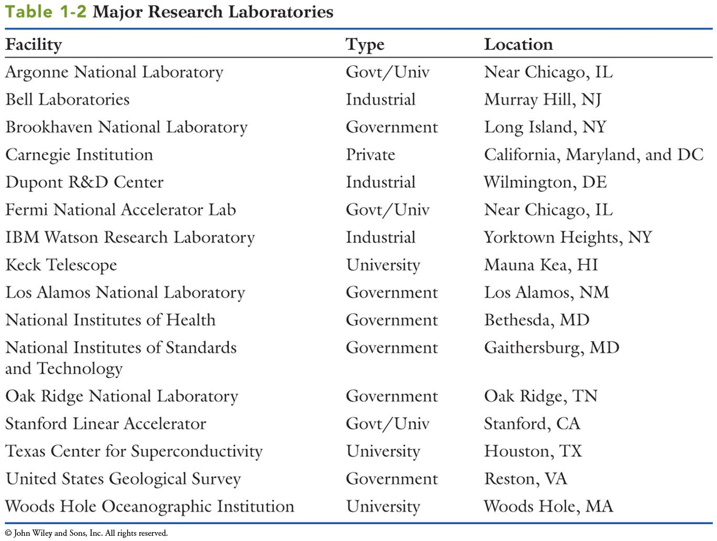
Major Research Laboratories

Slide 43
Communication Among Scientists
Collaboration
Scientific Meetings
Peer reviewed Journals
Cornerstone of science

